Slide 1


Whipple Consulting Engineers

Slide 2
Community Meeting
Grandview Addition
April 14th, 2026
Time for questions and comments will be available at the end of this presentation.
This meeting is being recorded and will be summarized and submitted to the City of Spokane.

Slide 3
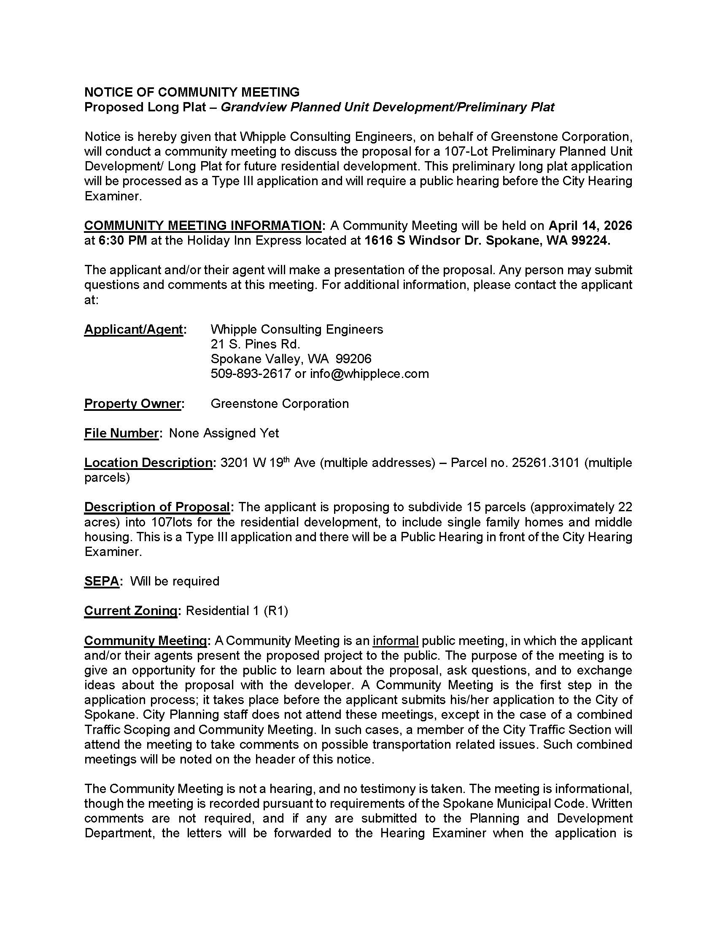
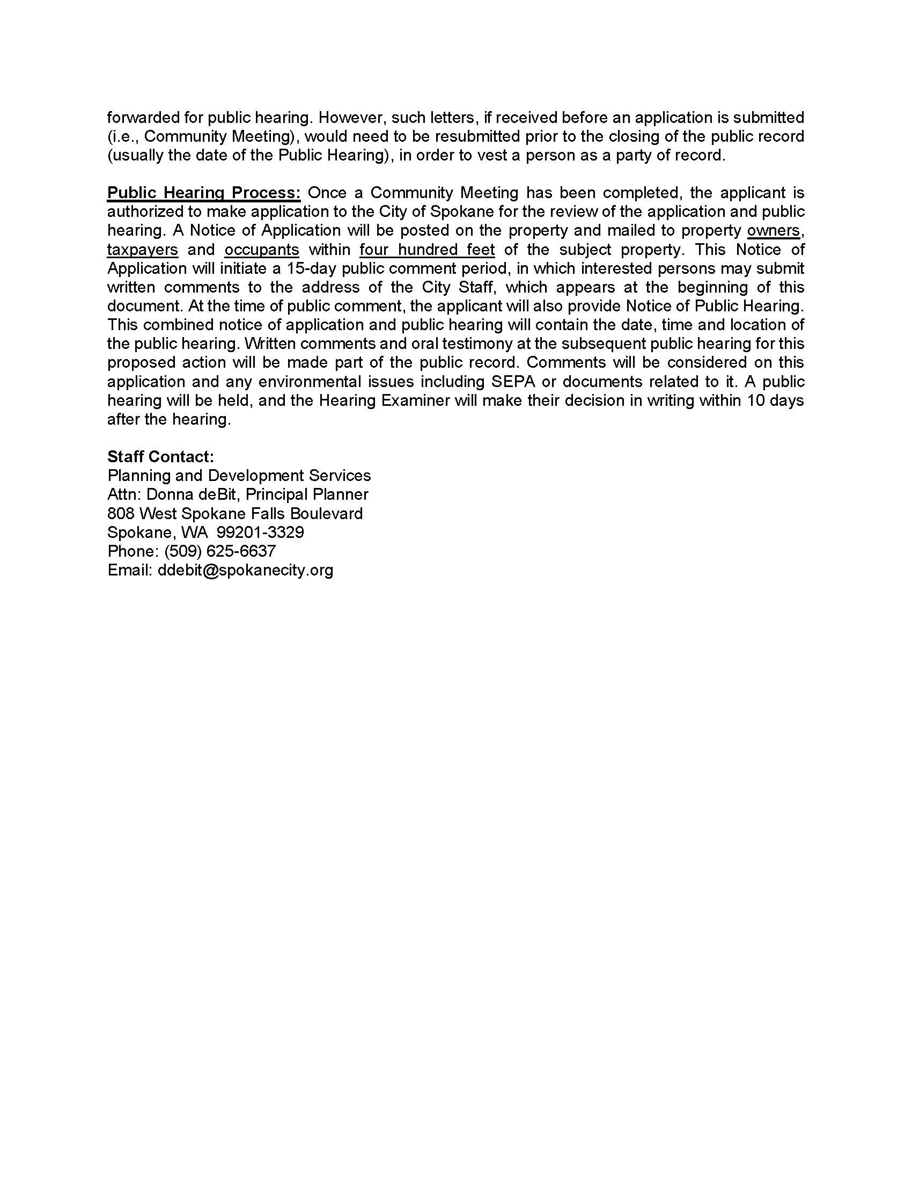

Mailer

Slide 4
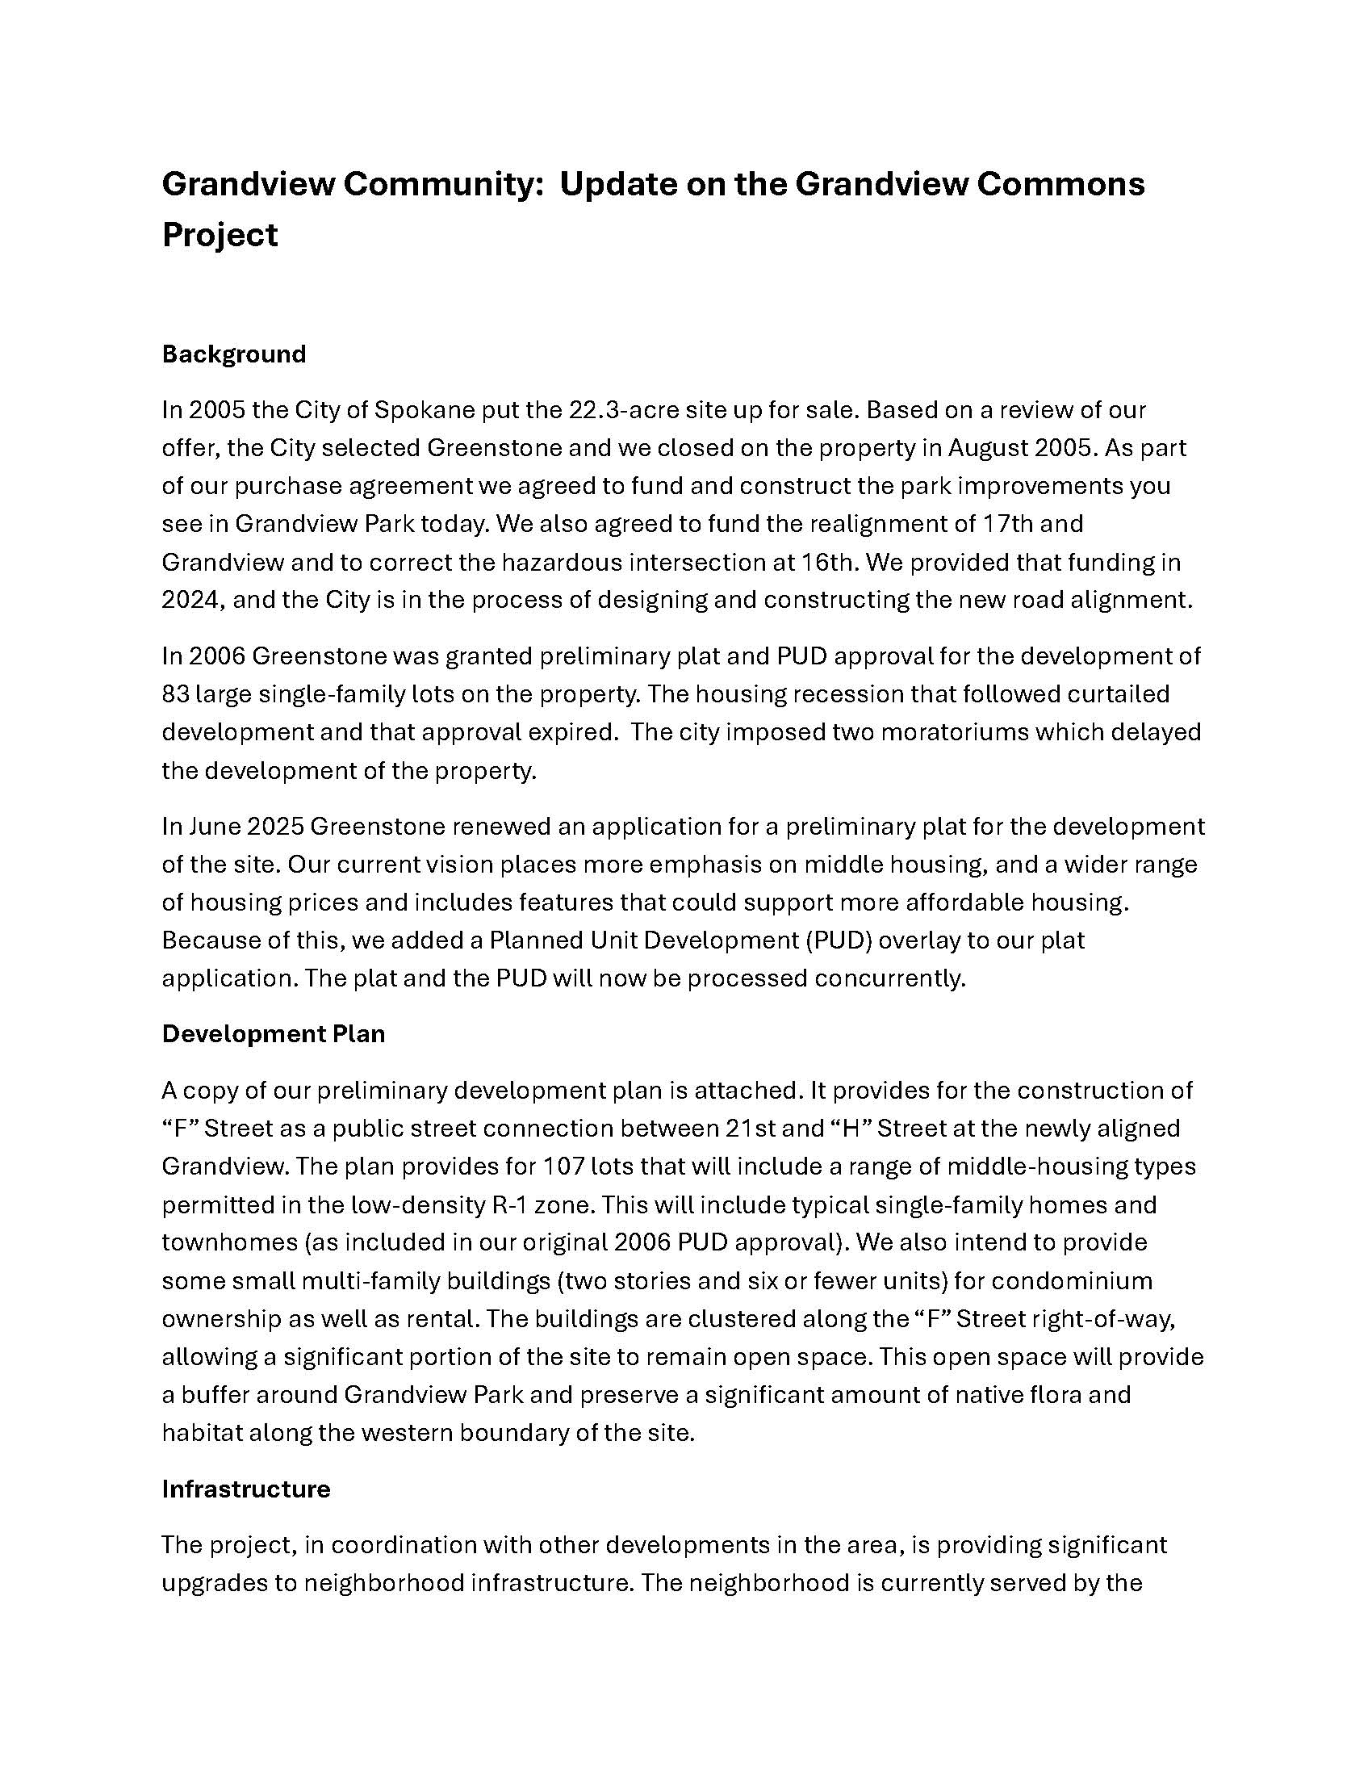
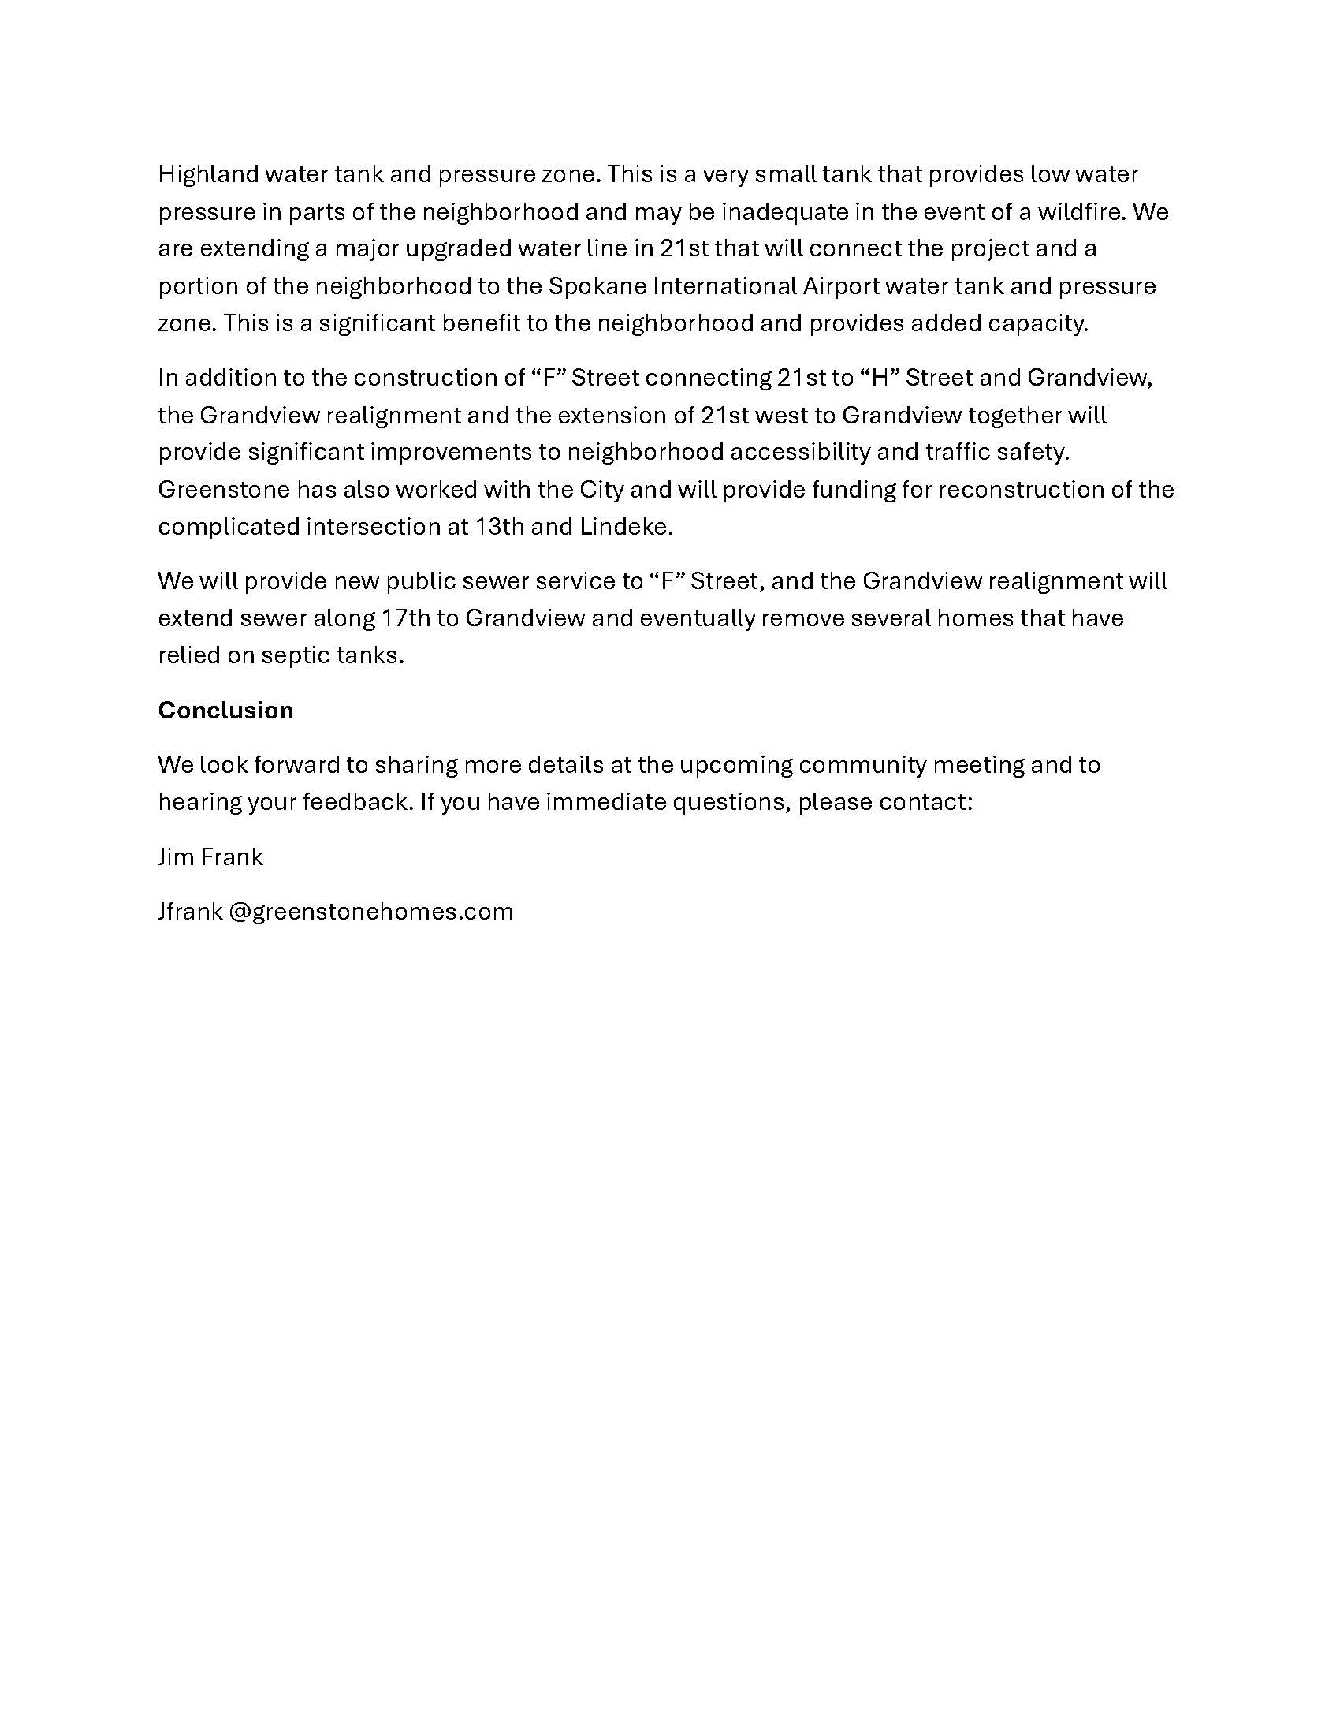
Mailer

Slide 5
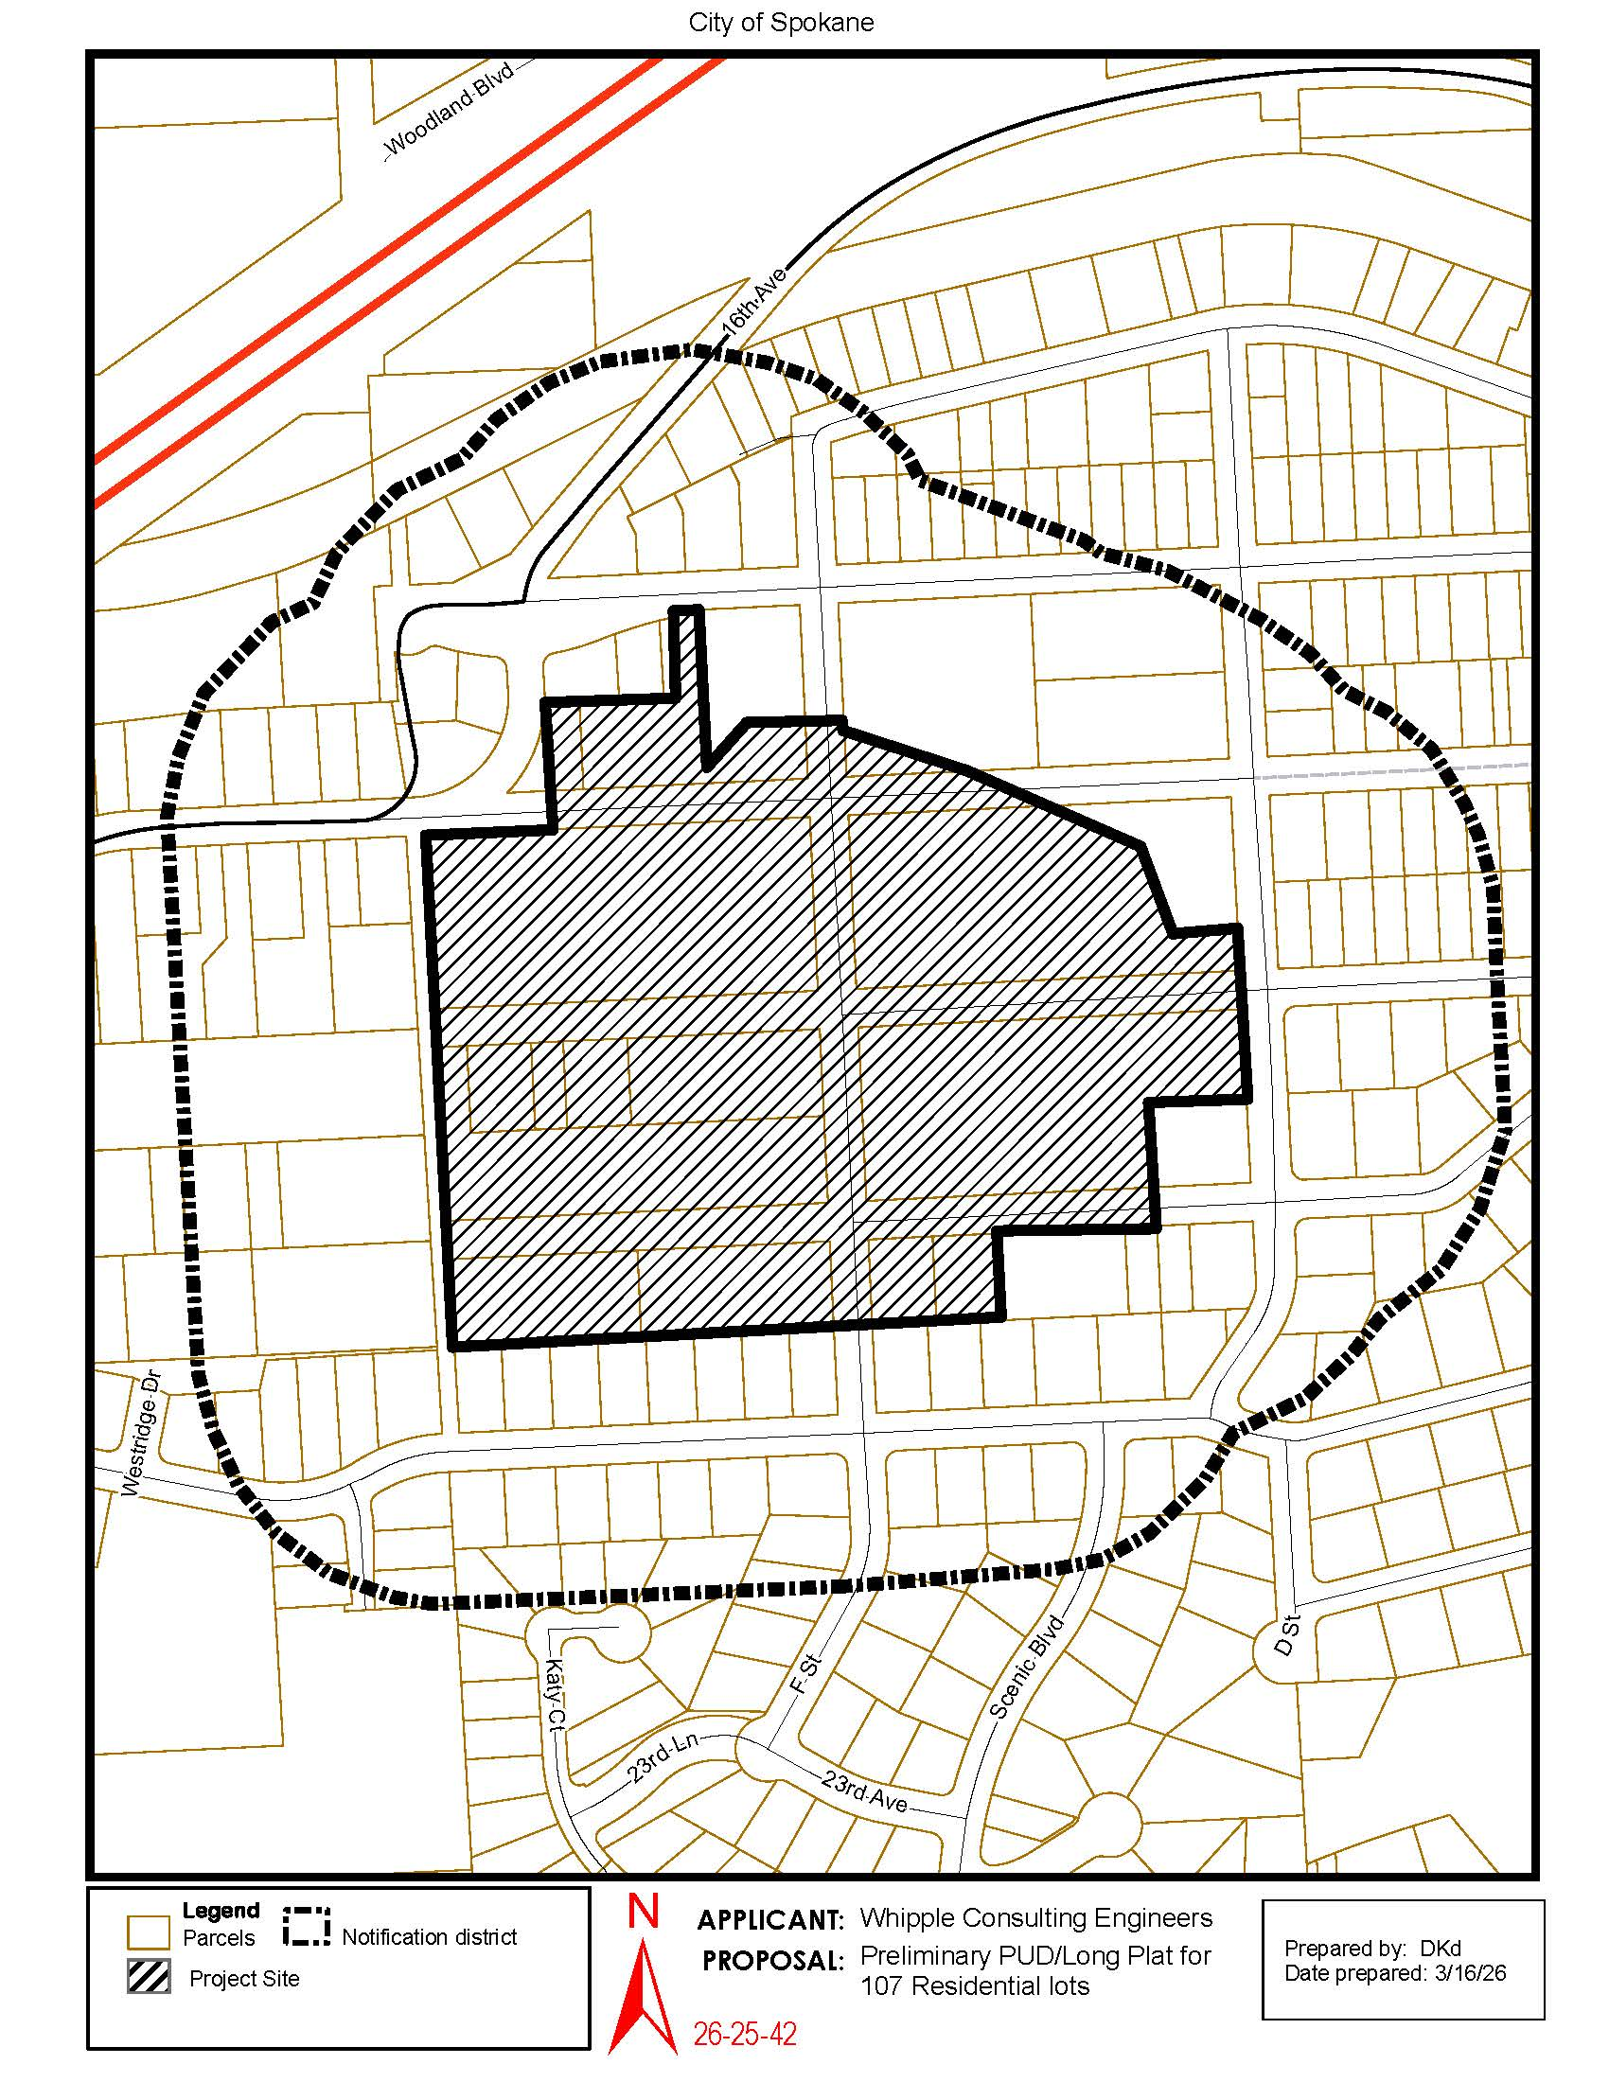
Mailer

Slide 6
Community and Traffic S c o p i n g Meeting Outline
Community Meeting (Presentation/Q&A)
  Overview of the Project
  Project Zoning & Comprehensive Plan
  Overview of Trip Generation
  Public Comments

Slide 7
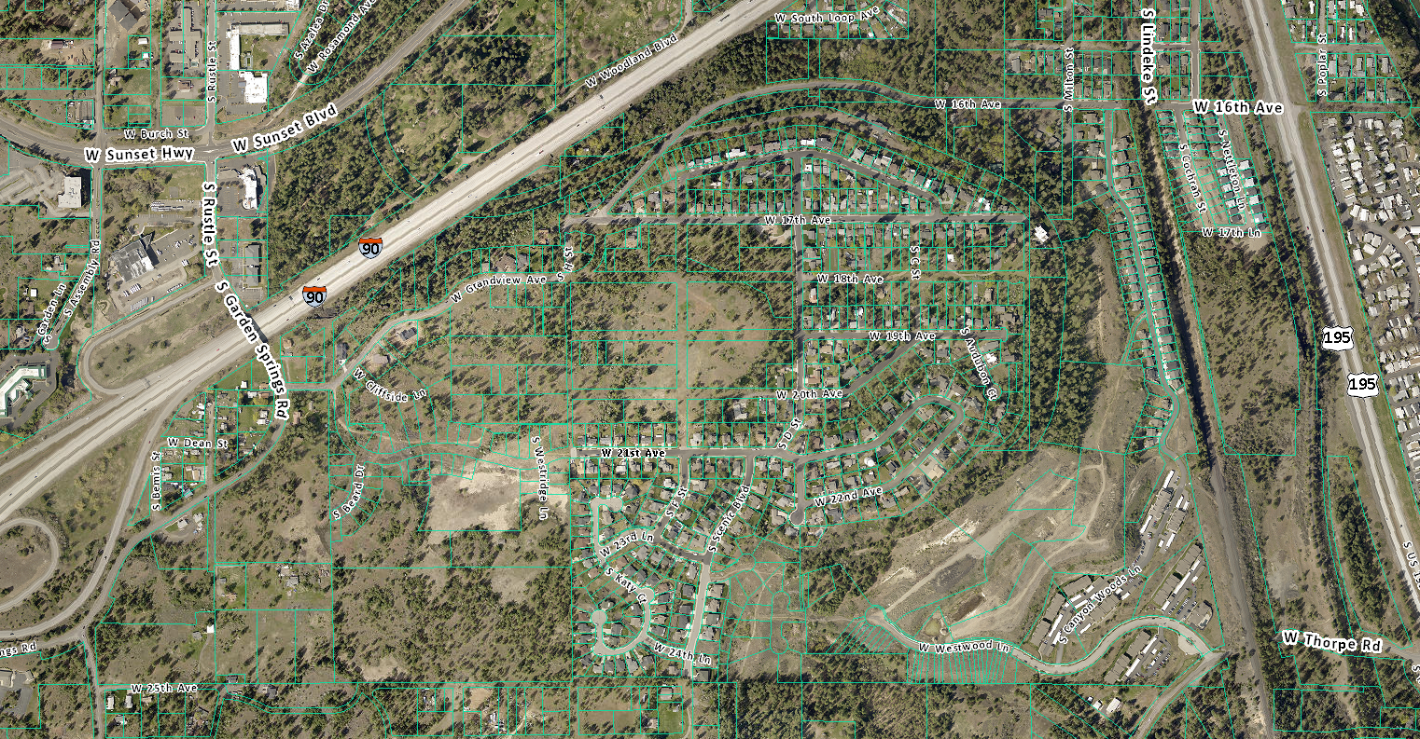
Vicinity Map
Site

Slide 8
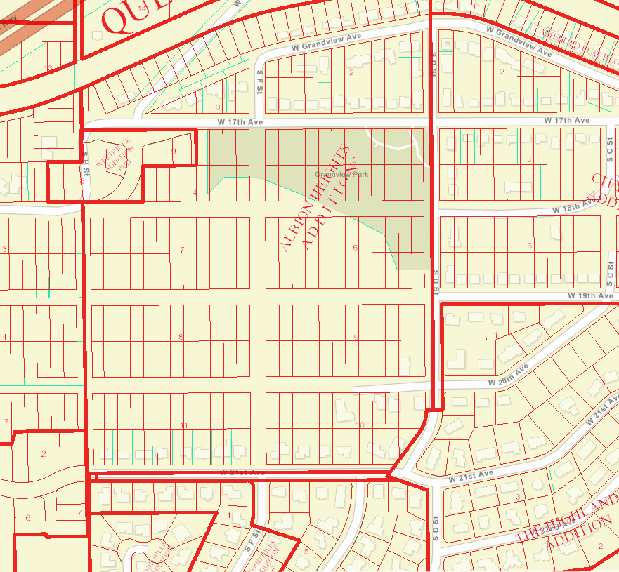
Existing Platting
110
lots
Parcel Map
Albion Heights Existing Underlying Plat

Slide 9
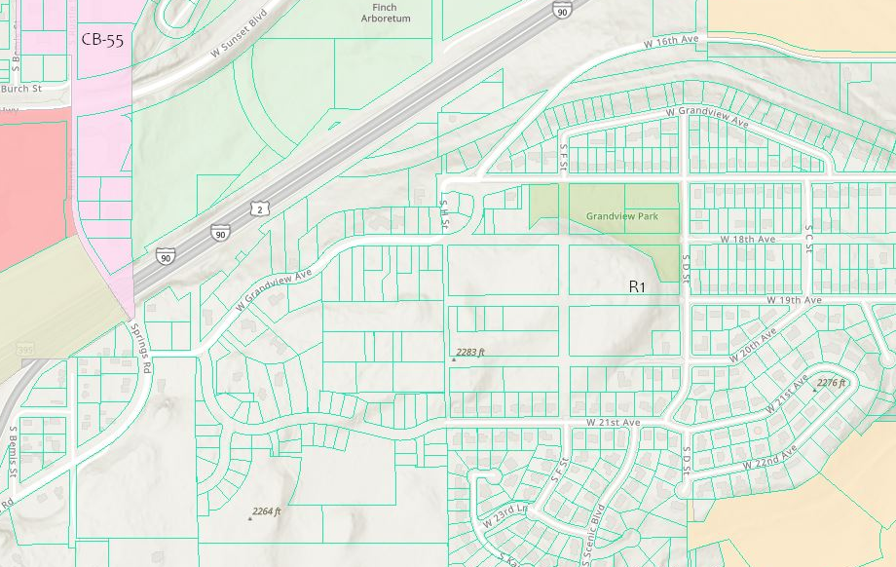
Development
Zoning-
City of Spokane
(R1)(4-10 Units/Acre)
R1
GC-70
CB-55
OR-70
R1
RMF

Slide 10
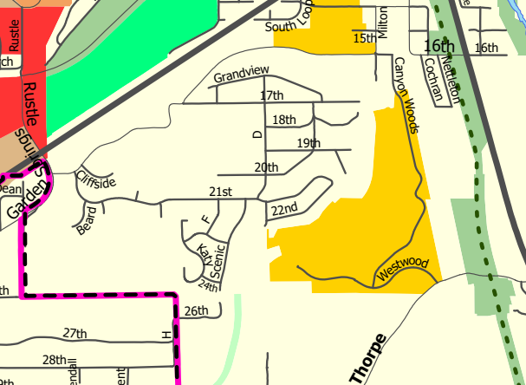
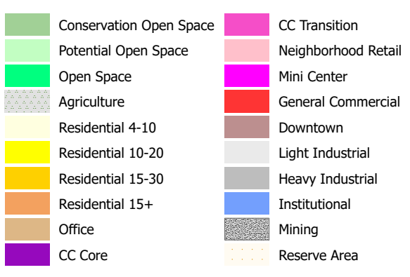
Comprehensive
Plan-
City of Spokane
(Residential Low)
Residential
Low

Slide 11
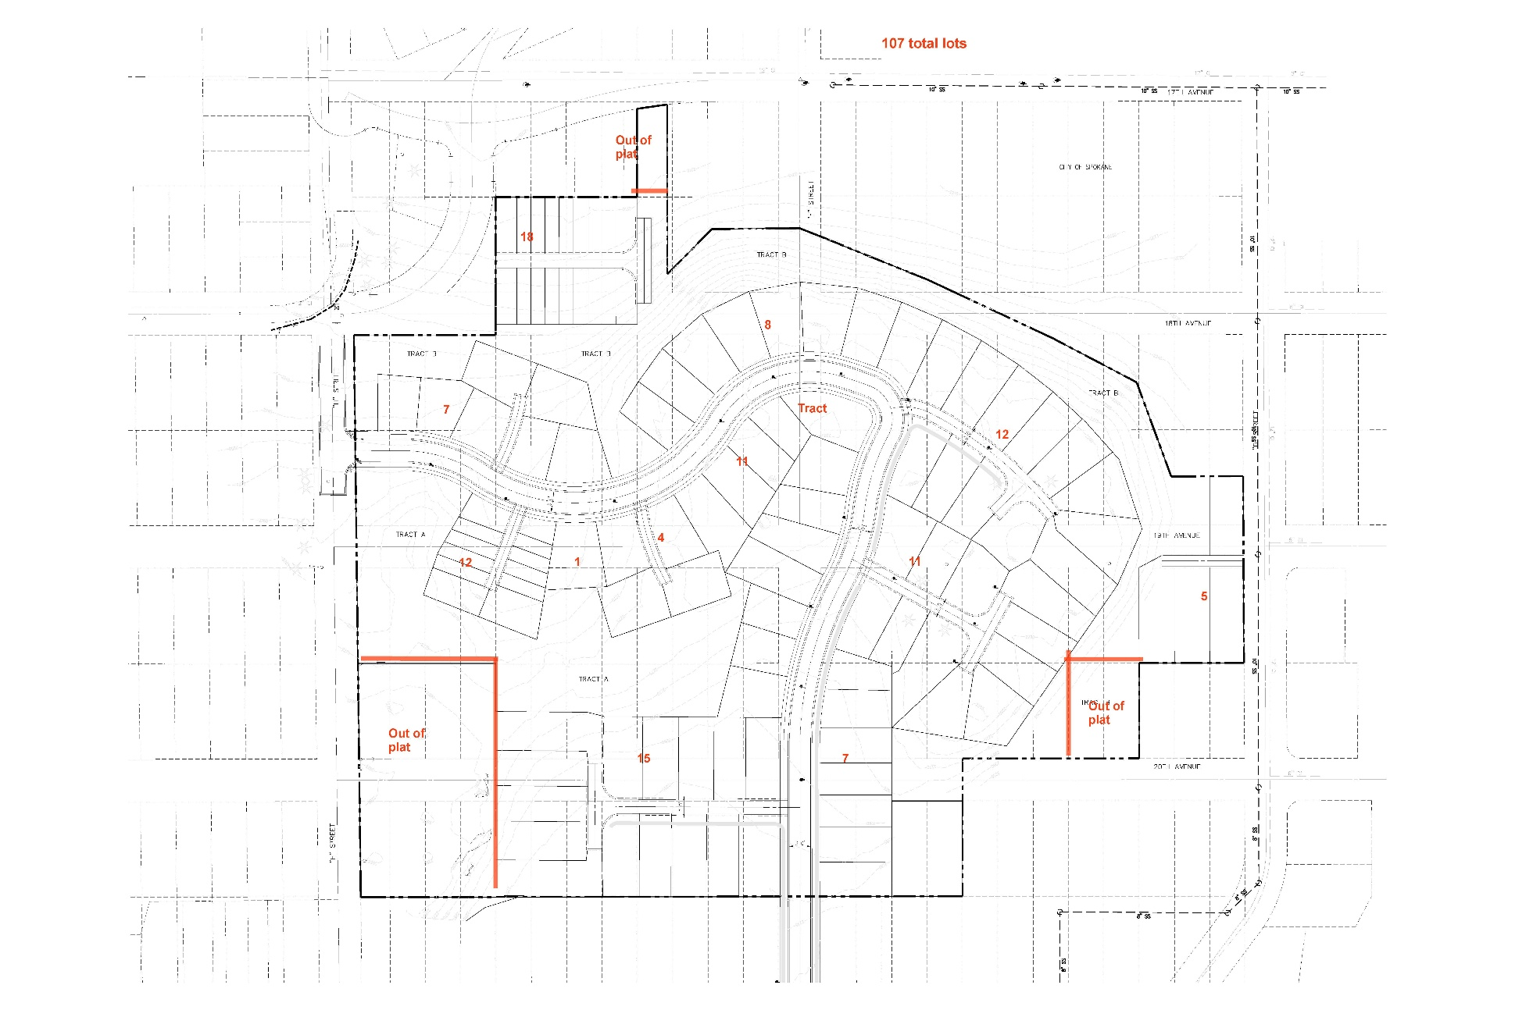
Preliminary Site Plan

Slide 12
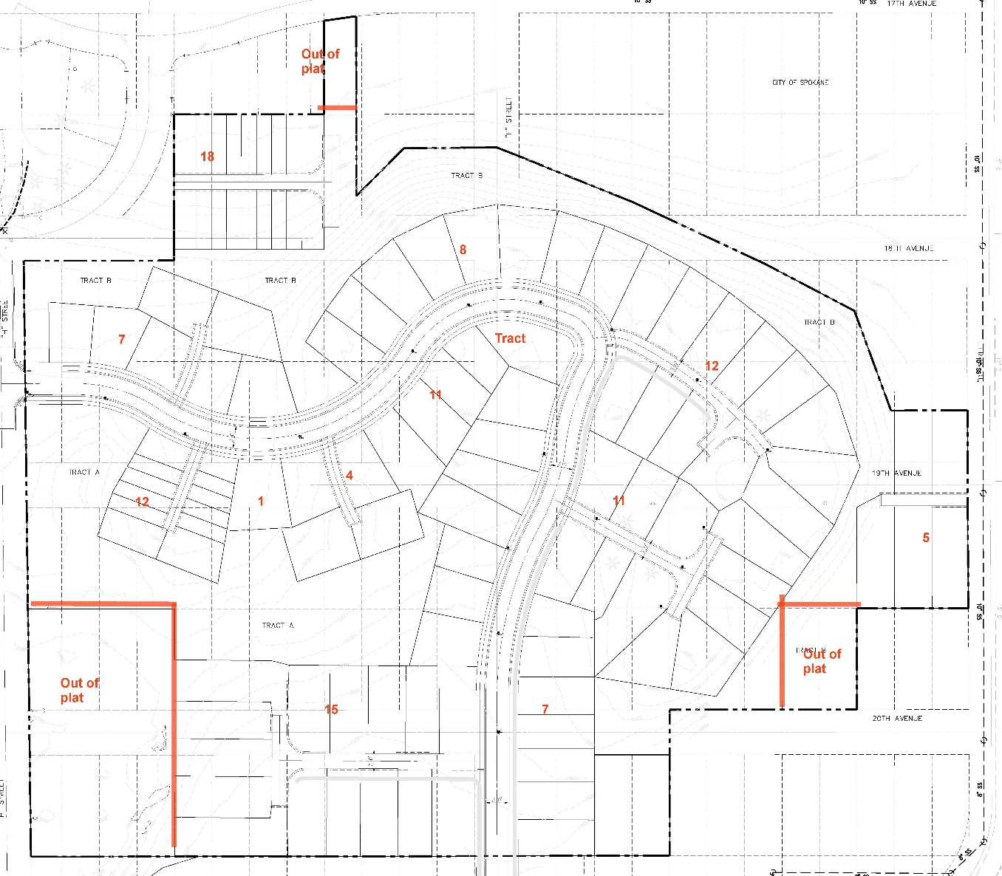
Project Description
22.35 Acres +/-
Residential Single Family/Missing Middle
107 Lots
Density:
  Density Allowed: 4-10 Units/Acre
  Density Proposed: up to 10 Units/Acre

Slide 13
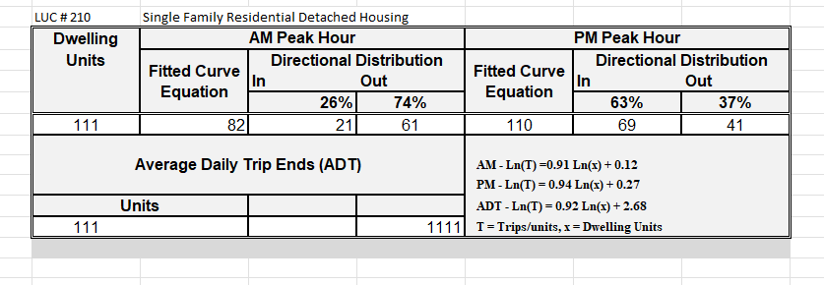
Trip Distribution TBD

Slide 14
Public Comments
22.35 Acres +/-
Residential Single Family/Missing Middle
107 lots
Density:
  Density Allowed: 4-10 Units/Acre
  Density Proposed: up to 10 Units/Acre
Please provide examples of concerns in this area. Your comments are being recorded and will be summarized and submitted to the City of Spokane.

